Slide 1



BLINKIT ORDER AND IT ‘ S REPORT
Karanam Naga Venkata Sai Ganesh - 23MH1A0523
Afrid Molla - 23MH1A0536
Gangadhar Valeti - 23MH1A0563
Abhinav Voduri - 23MH1A0569

Slide 2
CONTENTS
Abstract
Introduction
System Requirements
Architecture
Uses of data analysis library
Advantages
Conclusion

Slide 3
ABSTRACT
In the rapidly evolving landscape of e-commerce, efficient order fulfillment and customer satisfaction play a critical role in the success of any platform. This project focuses on analyzing Blinkit’s order dataset to uncover key insights and patterns related to customer behavior, product demand, delivery efficiency, and feedback trends. The analysis employs Python’s powerful data manipulation and visualization libraries such as Pandas , Matplotlib, Numpy and Seaborn to perform exploratory data analysis (EDA), data cleaning, and insightful visualization. This project identifies top products, common order types, delivery issues, and customer feedback trends. By analyzing and segmenting the data, it uncovers areas for improvement in operations and strategy. The goal is to help Blinkit enhance customer experience and streamline logistics through data-driven insights.

Slide 4
INTRODUCTION
In the fat-packed quick-commerce sector, data is key to making informed decisions.Analyzing order data helps improve service quality and operational efficiency.It also supports strategic planning for customer satisfaction and business growth.
This project analyzes Blinkit’s order data using Python.It aims to uncover insights about delivery trends,payment methods, and customer behavior.Python libraries like Pandas, Matplotlib, and Seaborn are used for data handling and visualization.
We used Python 3+ for coding and Jupyter Notebook for running the analysis. Key libraries include Pandas for data manipulation and Matplotlib/Seaborn for visualizing trends.These tools enable easy exploration and graphical representation of complex datasets.
The main goal is to extract insights from Blinkit’s order data by identifying delays, popular items, and customer trends. These findings help improve logistics, marketing, and user satisfaction.

Slide 5
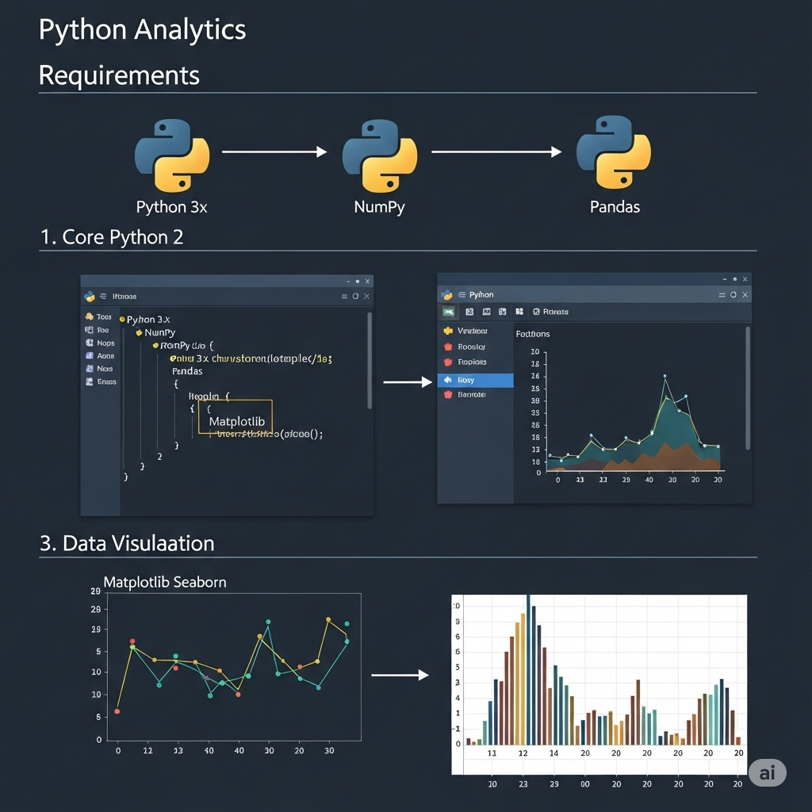
SYSTEM REQUIREMENTS
SOFTWARE REQUIREMENT :
OPERATING SYSTEM : The analysis can be performed on Windows, MacOS and Linux. Ideal for running Jupyter Notebook or any Python IDE smoothly.
Python : Python 3.x is required for running the analysis.
Libraries : 1. Numpy : Install the Numpy library using pip ( python installation package). It is a powerful python library used for numerical communication. pip install numpy 2. Pandas : Install the Pandas library using pip, a package manager for Python . pip install pandas

Slide 6
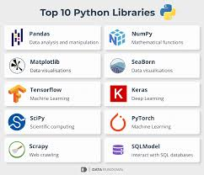
3. Matplotlib : It is used for plotting graphs. Install it using pip command. pip install matplotlib
4. Seaborn : Install it using pip command and it is used for advanced data visualization. pip install seaborn
5. Hardware requirements : a. Minimum 4GB RAM (8 GB recommended for better performance) b. Intel i3 processor or higher . c. At least 500 MB free storage for environment setup and dataset.

Slide 7

ARCHITECTURE
The architecture of the Blinkit order report analysis, built using Python along with Numpy, Pandas, Matplotlib and Seaborn , follows a systematic workflow designed to transform raw transactional data into actionable business insights.
The analytical workflow generally involves data exploration, grouping, cleaning and visualization to extract meaningful insights from the data set.

Slide 8
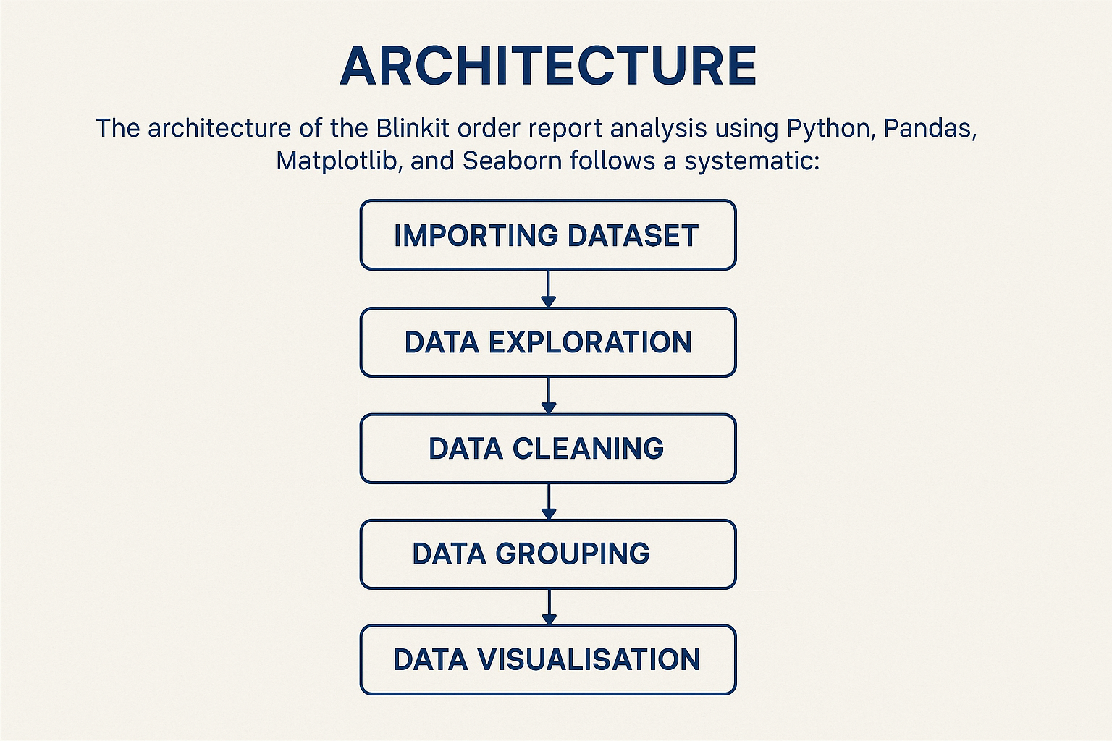


Slide 9
ADVANTAGES
1. Understand Customer Choices : Helps Blinkit know which products are ordered the most and which payment methods are used often.
2. Spot Delivery Issues : Finds out where and why delivery delays or problems are happening.
3. Improve Customer Service : Identifies reasons for order cancellations or bad feedback to improve customer experience.
4. Easy Decision Making : Clear charts and graphs make it simple to plan and take business decisions.
5. Better Stock and Delivery Planning : Helps in organizing inventory and delivery routes based on real data.
6. Data-Driven Growth : Turns raw data into useful insights for growing the business smartly.

Slide 10
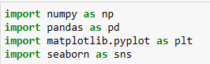
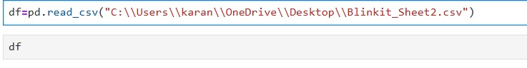
IMPORTING DATASET
The project starts with acquiring the Blinkit order dataset from kaggle and structured data sources.This dataset includes detailed information about orders, delivery status, payment modes, and customer feedback.Once collected, the data is loaded into Python environment using Pandas library.
Pandas converts the raw data into a well-organized DataFrame,enabling efficient access and manipulation. This structured format forms the foundation for accurate exploration , preprocessing and visualization.

Slide 11
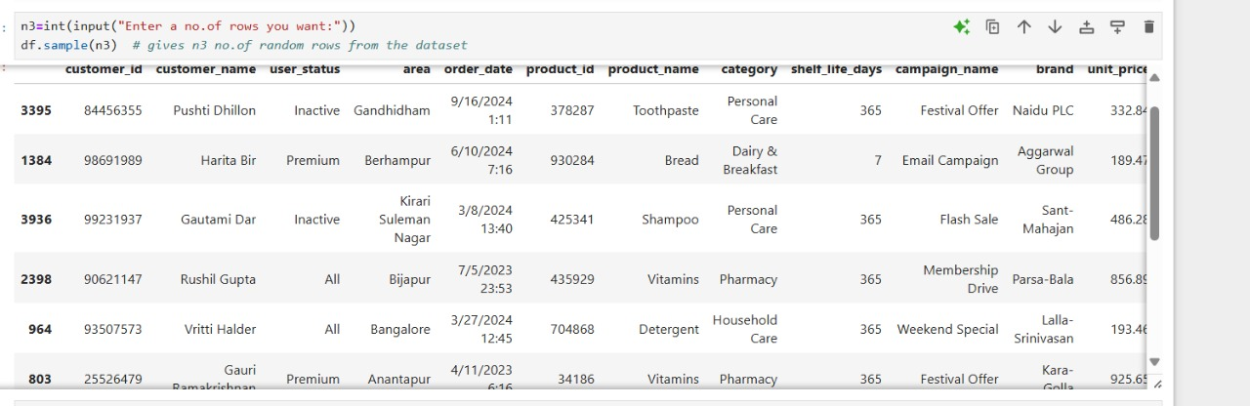
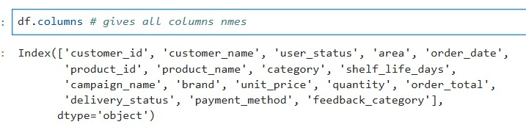
DATA EXPLORATION( EDA)
Data exploration means getting to know the data before doing deep analysis. In this project, we checked Blinkit’s order data to see how it is structured, what columns it has, if any data is missing, and basic number summaries.
We used Python to:
Look at the first few rows of data
Find missing values and data types
See basic stats like order quantity or price
Spot common trends like popular payment methods or order status.

Slide 12
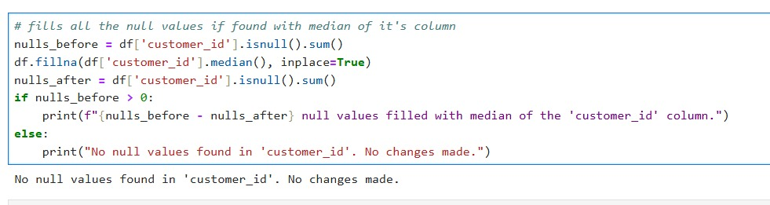
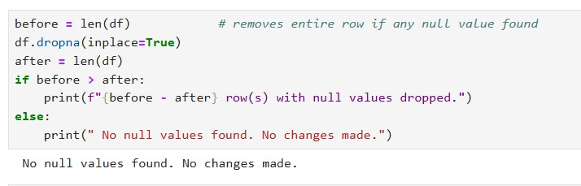
DATA CLEANING( SCRUBBING)
Data cleaning is the process of fixing or removing wrong, missing, or duplicate data. It helps make the data ready for correct analysis.
In this project, we cleaned the Blinkit order data by:
Removing rows with missing or blank values
Fixing incorrect data entries (like wrong date or spelling)
Removing duplicate rows
Changing column formats (like converting strings to numbers or dates)

Slide 13
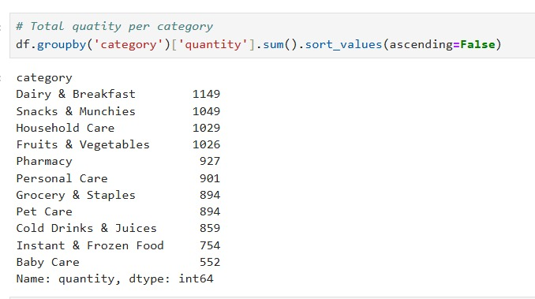
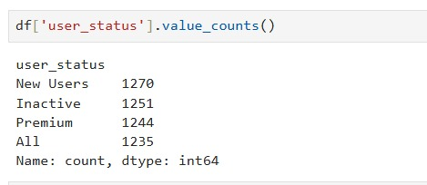
DATA GROUPING ( Split - Apply - combine )
Data grouping means arranging data into categories to find useful patterns.
In this project, we grouped the Blinkit data to:
See total orders by payment method
Count orders based on order status (like delivered, canceled)
Find total quantity or sales for each product
Check delivery trends by area or date

Slide 14
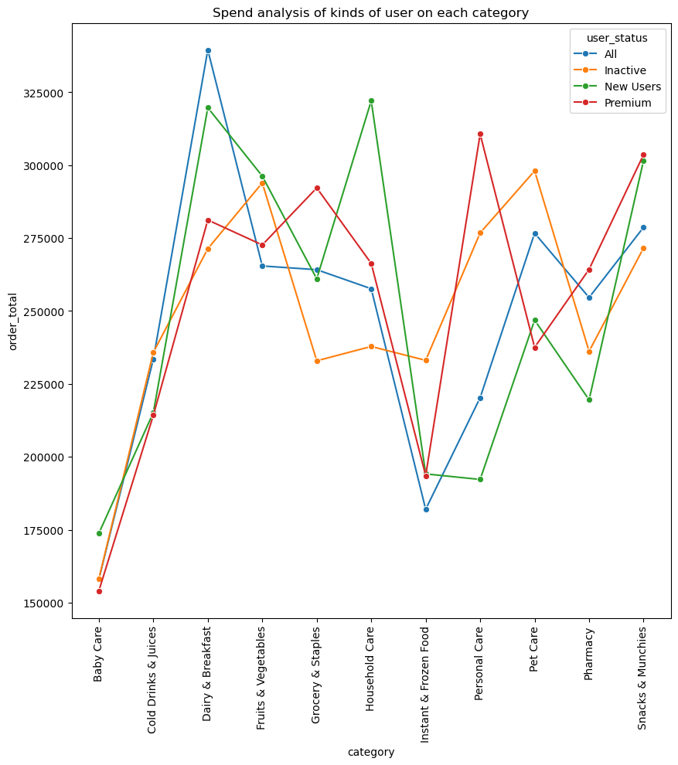
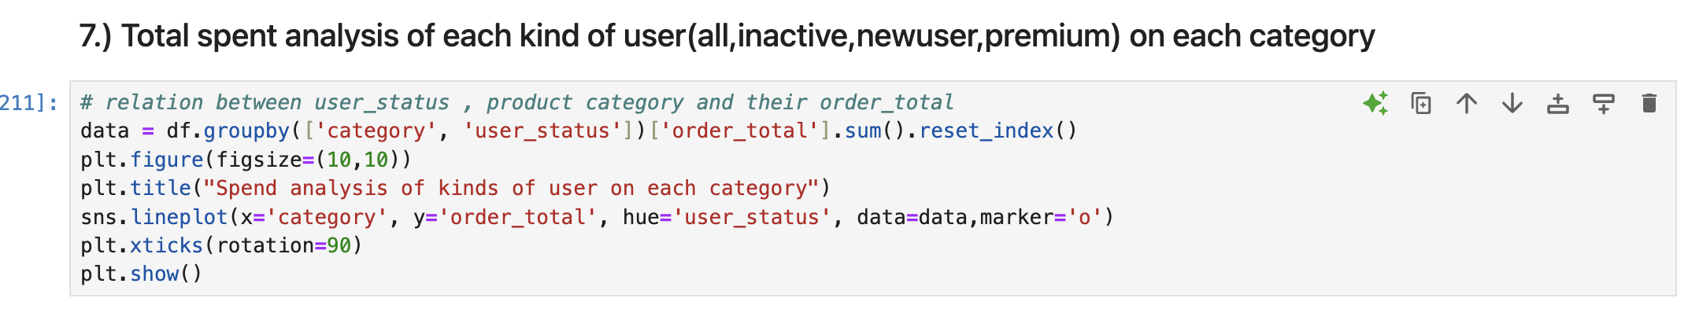
DATA VISUALISATION
Data visualization means showing data in the form of charts and graphs to make it easier to understand.
In this project, we used Python libraries like Matplotlib and Seaborn to create:
Bar charts to show number of orders by payment method or product
Pie charts to display order status percentages
Line graphs to track orders over time
Heatmaps to find patterns in delivery areas or time slots

Slide 15
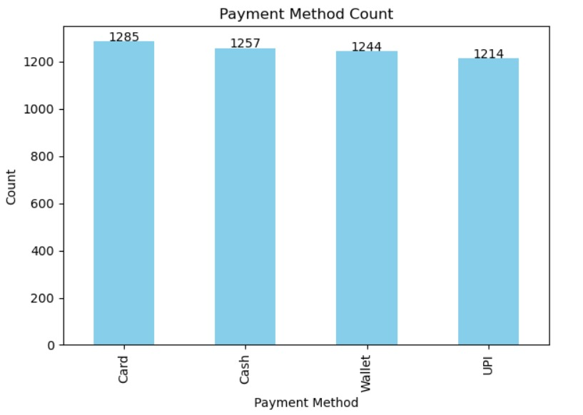
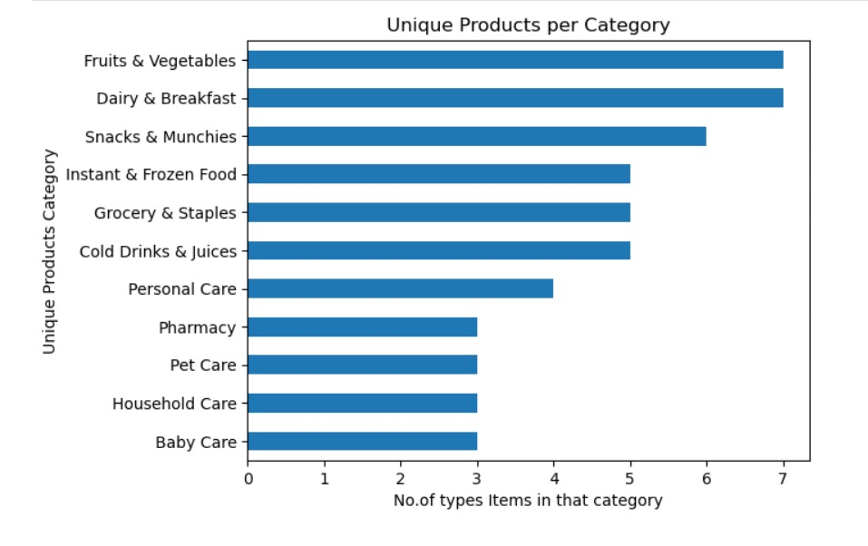
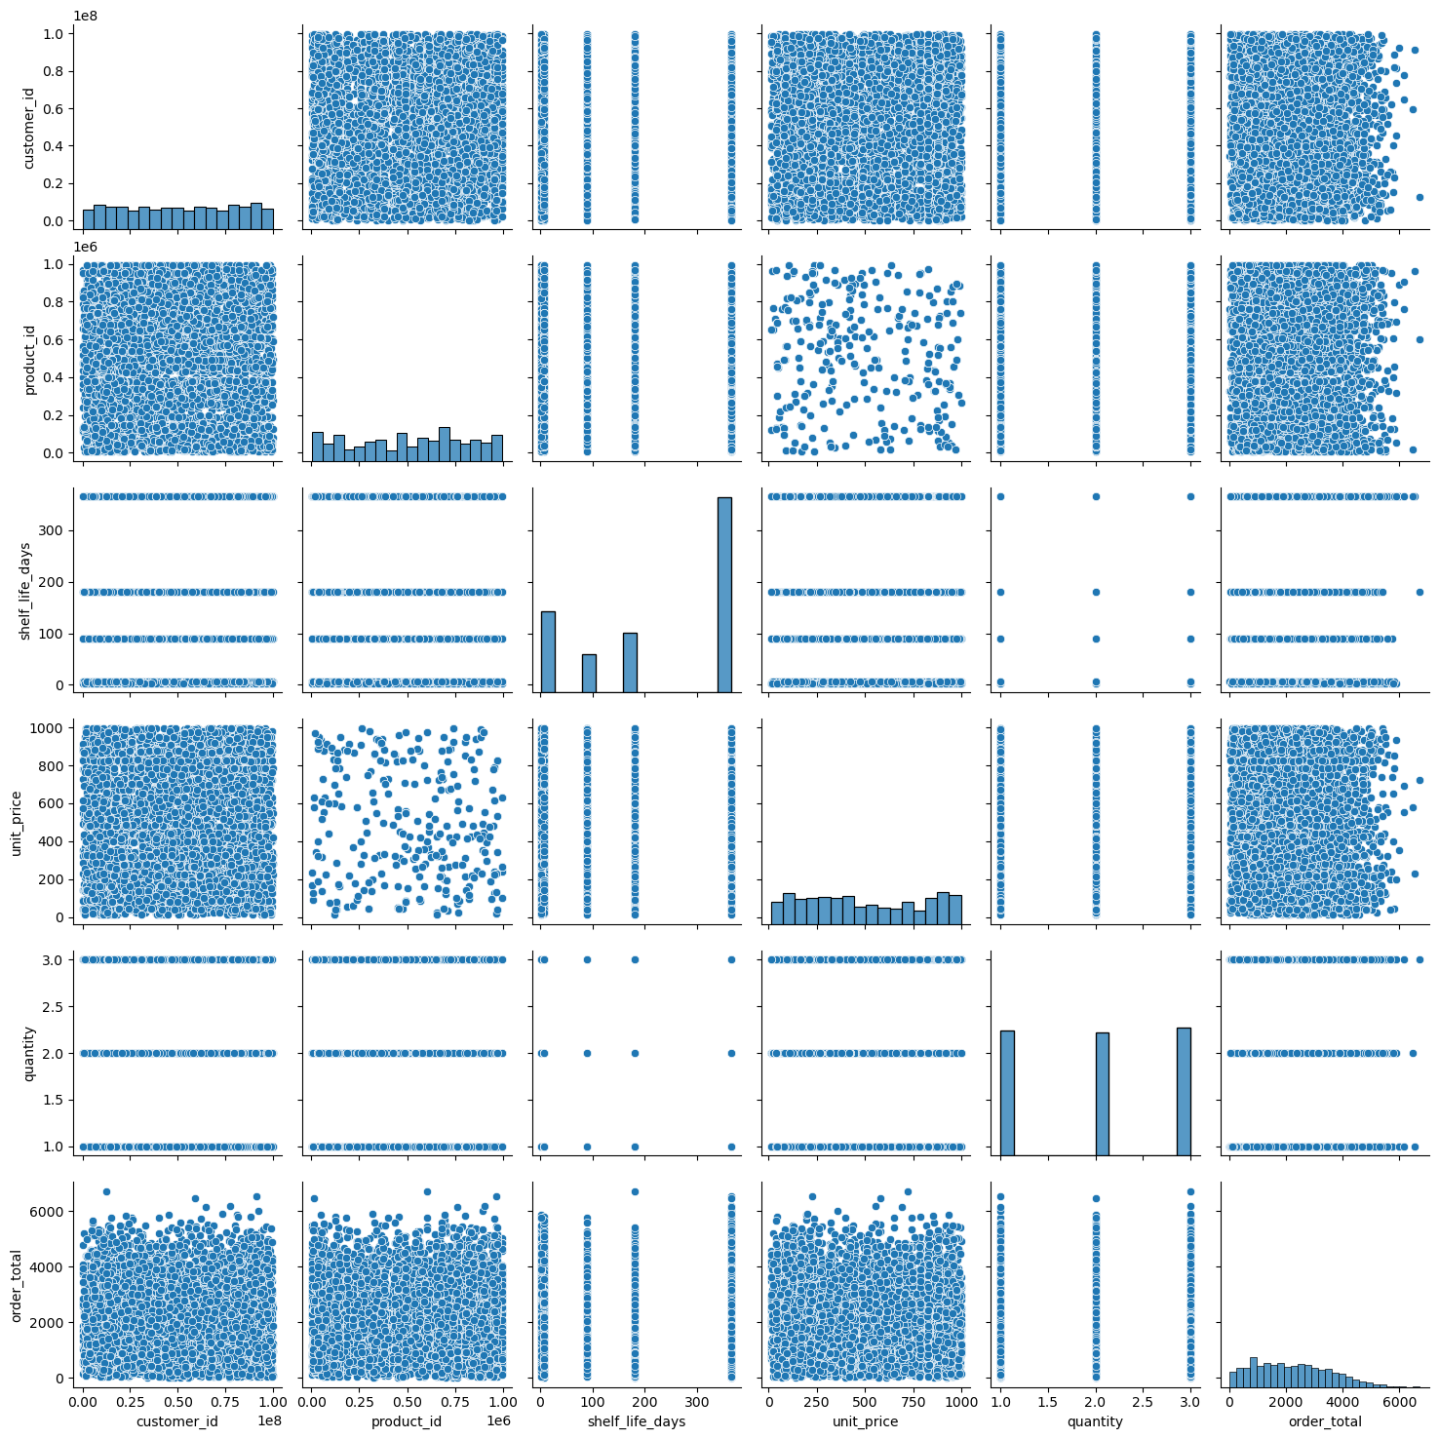
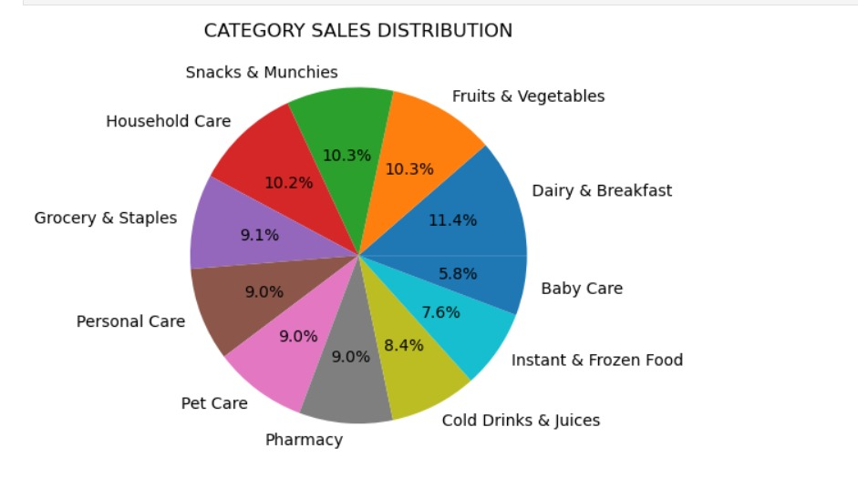
DATA VISUALIZATION

Slide 16
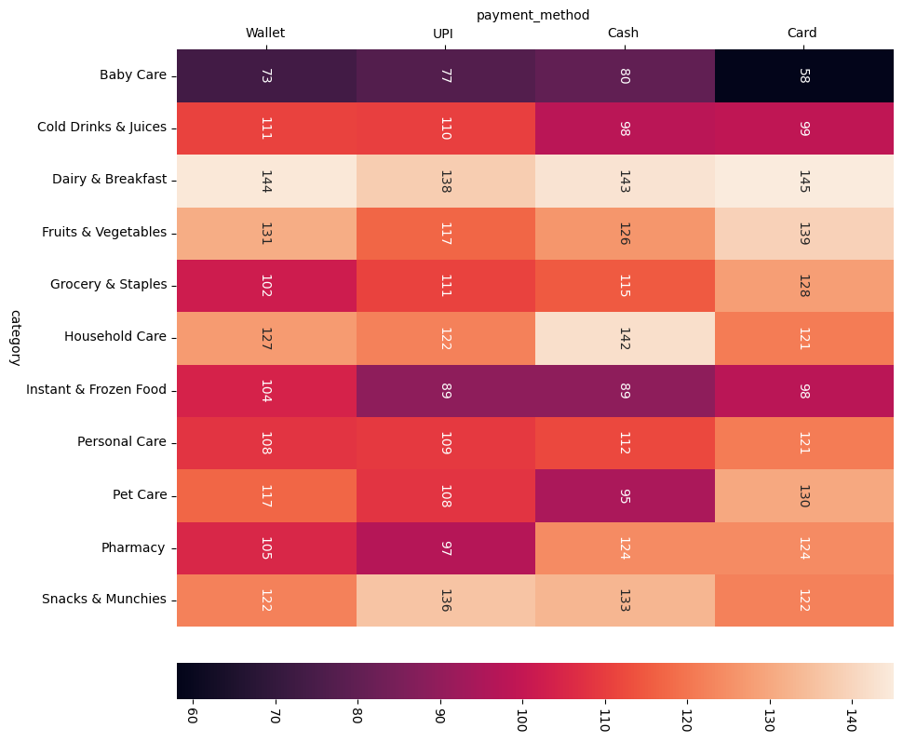
DATA VISUALIZATION

Slide 17
DATA ANALYSIS LIBRARIES AND USES
PANDAS : It is used in data manipulation and analysis. It can load and clean datasets Eg: CSV files It performs filtering, grouping, merging and summarization. It handles missing data, create new columns, and manipulate date/time formats.
Usage in project : Analyze total orders by city, filter out delayed deliveries, or group orders by payment method.
Numpy : It is called Numerical python used for numerical operations on arrays and matrices. It include statistical unctions : mean( ), median( ),std( ). It is the foundation for other libraries like Pandas and Scikit-Learn.
Usage in project : It calculates average delivery time, order amount etc.,and Filter fast deliveries and analyze relationships.

Slide 18
DATA ANALYSIS LIBRARIES AND USES
Matplotlib : It is used for basic plotting like line plots, bar charts, histograms, piecharts. It customize visualizations ( labels, legends, gridlines, etc.). It save charts for reports or presentations.
Usage in project : It visualize number of orders per city or per day. It plot delivery success vs delays. Shows order trends over time using line charts or histograms.
Seaborn : Built on Matplotlib with prettier, more statistical plots. Great for distributions, category comparisons, and correlation analysis. Supports heat maps, box plots, violin plots and pair plots.
Usage in project : Create heatmaps for delivery patterns across regions and use box plots to compare order values or delivery times by payment method.

Slide 19
REFERNCES
Blinkit Official Website – Company Overview and Services https://blinkit.com
Kaggle – Online Retail Datasets (for data structure reference and analysis approach) https://www.kaggle.com/datasets
Pandas Documentation – Python Data Analysis Library https://pandas.pydata.org/docs/
Seaborn Documentation – Statistical Data Visualization in Python https://seaborn.pydata.org/
Matplotlib Documentation – Data Plotting Library https://matplotlib.org/stable/contents.html

Slide 20

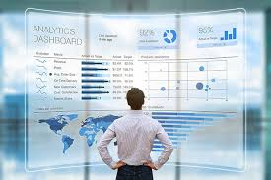
CONCLUSION
This project used Python libraries like Pandas, NumPy, Matplotlib, and Seaborn to clean, explore, and analyze Blinkit's order data. We removed missing values, fixed data formats, and grouped the data to find useful patterns. Visualizations helped us clearly understand trends in product demand, payment methods, and delivery issues.
The insights revealed ways to improve customer satisfaction and delivery efficiency. This analysis also supports smarter business decisions and better planning. Overall, the project shows how data analytics can help Blinkit grow and serve its customers more effectively.

Slide 21

THANK YOU

